Slide 1
Strongly Connected Components
NAMAN ANAND
200101070
CSE dept

Slide 2
Strongly Connected Components
A strongly connected component (SCC) of a directed graph is a maximal strongly connected subgraph. A directed graph is strongly connected if there is a path between all pairs of vertices.
A strongly connected component is the portion of a directed graph in which there is a path from each vertex to another vertex.
0
1
5
0
1
5
3
2
4
6
7
3
2
4
6
7

Slide 3
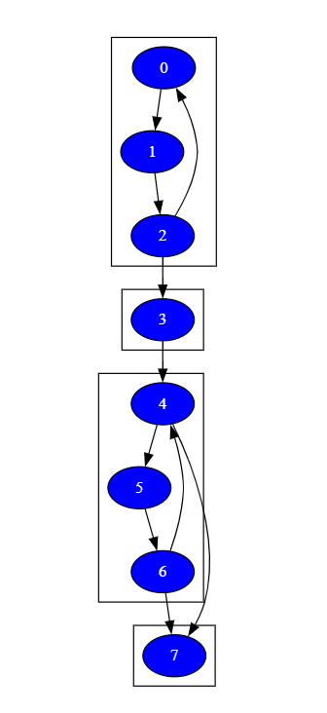
Kosaraju Algorithm
3 STEPS :
DFS ON THE ORIGNAL GRAPH
TRANSPOSE THE GRAPH
DFS ON THE TRANSPOSE GRAPH

Slide 4

Node Class

Slide 5

Linked List Class

Slide 6
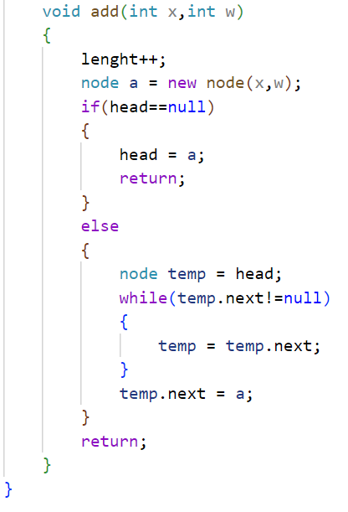
Linked List Class

Slide 7

Graph Class

Slide 8
DFS
Starts from vertex 0.
0
1
5
3
2
4
6
7
Visited
0
Stack

Slide 9
Perform DFS on the whole graph
0
1
5
3
2
4
6
7
Visited
0 | 1 | 2 | 3 | 4 | 5 | 6 | 7
Stack
3 | 7 | 6 | 5 | 4 | 2 | 1 | 0

Slide 10
Transpose the graph
0
1
5
3
2
4
6
7

Slide 11
DFS on the Transpose Graph
Start from the top vertex of the stack. Traverse through all of its child vertices.
Once the already visited vertex is reached, one strongly connected component is formed.
0
1
5
3
2
4
6
7
Visited
0 | 1 | 2 | 3
Stack
3 | 7 | 6 | 5 | 4 | 2 | 1
SSC
0 | 1 | 2 | 3

Slide 12
Finally we get all strongly connected components
0
1
5
3
2
4
6
7

Slide 13
Time Complexity
O(V+E)
TWO DFS AND TRANSPOSE
EACH DFS HAVE COMPLEXITY O(V+E)

